Slide 1

Introduction to Compiere
David Newbury, Engyn I.T. Pty. Ltd.

Slide 2
Open Source is Changing the World
Open Source is "the most significant all-encompassing and long-term trend that the software industry has seen since the early 1980s" and will "fundamentally change the value proposition of packaged software for customers."
-- Anthony C. Picardi
SVP, Global Software and Services
IDC
Source: http://www.idc.com/getdoc.jsp?containerId=prUS20311906
Notes:
Compiere is an open source solution. You’re going to hear a lot about Compiere’s open source advantages in my presentation today. As IDC’s software Guru Anthony Picardi says, “Open source is the most significant all-encompassing and long term trend that the software industry has seen since the early 1980’s and will "fundamentally change the value proposition of packaged software for customers.“ That’s a bold claim and, as we’ll discuss, a very real claim when it comes to ERP solutions and Compiere.

Slide 3

What is your Situation?
Outgrown your current environment?
Globalizing your business?
A new company looking for a solution?
Frustrated with the cost of your current system?
Struggling with multiple business application silos?
Notes:
There are many different reasons that businesses seek out an ERP solution. A few examples include: Outgrown your current environment, Globalizing your business, A new company looking for a solution, Frustrated with the cost of your current system, and Struggling with multiple business application silos. Let’s stop for a moment and discuss your situation…..

Slide 4

Problems with Traditional ERP
Complex
  Bloated with features you’ll never use
  Complicated and time consuming to implement
Inflexible
  Force you to modify your business to match the software
  Difficult to change once implemented
  Many local solutions won’t scale globally
Expensive
  Costly licenses, IT infrastructure, maintenance and upgrades
Proprietary, Locked-in
  Don’t control your own destiny
Traditional ERP is out of reach of SMBs and emerging markets.
Notes:
The reasons why mid sized businesses haven’t fully embraced ERP today is more about problems with traditional ERP products and vendor practices.
The products are complex--bloated with two decades worth of incremental functionality that mid-sized businesses like yours will never use. This complexity requires you to increase your efforts in implementation and training to hide the functionality or in rollout through additional training.
The products are inflexible—All of the leading ERP solutions were architected in the 1980’s or earlier and rely on 3rd generation programming practices. Customization is possible, but it required modifications to the 3rd generation code. This requires users to make one of two unpleasant choices. One choice is to modify your business practices to match the product’s out-of-the-box capabilities. The other choice is to make changes to the code to match your current processes and capabilities. Pursuing this option makes your solution difficult to maintain and upgrade.
A further challenge is if your want to grow your business in a dimension that the product doesn’t support out of the box, such as global expansion. The answer in many cases is the product won’t scale.
The products are expensive—initial license fees of several thousands of dollars per user for ERP plus additional licenses for infrastructure software to support the ERP system. This is followed by annual maintenance fees for the software for access to support and upgrades. You will spend additional dollars on a large team of implementation consultants to deploy the solution and keep it current. In summary, there are high up front costs before you realize any benefits from your ERP system and significant costs over the lifetime of the system.
The proprietary products lock you in—especially if you adapt your business to the way the software works. If things don’t work out, there is a huge sunk cost.
These are daunting issues, but don’t be discouraged. The benefits of deploying ERP solutions that match your business needs are proven. The technology and business model need a few important changes and the ERP benefits are within the reach of a broader spectrum of businesses. Compiere has incorporated those changes into its open source product and business model.

Slide 5
Compiere’s Fresh Approach
Adapts to the way you do business
  Setup and re-configure the system without programming
  Quickly adapt to business change – change anything, anytime
Available at fraction of the cost of any competing solution
  Leverage the disruptive economics of open source
  No up-front software license fees
Backed by the reliability of a commercial corporation
  Experienced leadership
  Consistent processes for product innovation, quality and support
  Resources for flexible licensing, sponsored development and more
Notes:
Let’s take a look at Compiere’s fresh approach to ERP. Compiere’s focus is on making ERP Easier. Easier to evaluate and acquire. Easier to implement and use. And easier to extend and maintain.
Let me quickly layout the key advantages. We’ll go into more detail in a moment.
Compiere adapts to the way you do business. It lets you setup and re-configure the system without programming. You can quickly adapt the software to meet changing business requirements—without hiring an army of consultants and months of development.
Compiere changes the economics of ERP. For example, it eliminates up-front software license fees and changes the cost structure of implementation, customization and expansion. As a result, the financial outlay for your ERP solution is far less proprietary offerings but delivers the same benefits to your business.
Importantly, Compiere is a commercial open source vendor. While source code availability frees you from vendor lock-in, Compiere provides professional support and ongoing investment in product innovation. As a result there your solution has longevity and backing by a professional, revenue-generating software corporation.

Slide 6
Functional Introduction

Slide 7
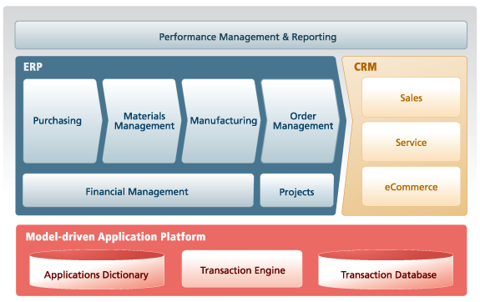
Integrated ERP and CRM Functionality
Notes:
Compiere delivers comprehensive ERP capabilities that enable you to automate your business processes. It includes modules for Financial Management. Purchasing. Materials Management, Manufacturing, Order Management and Project Accounting. Customer information is available to automate sales and service processes. Compiere includes a web store that enables you to sell over the internet.
Performance management and reporting capabilities in Compiere enable you to make informed decisions, create operational efficiencies, improve customer service and measure revenue and profit.

Slide 8
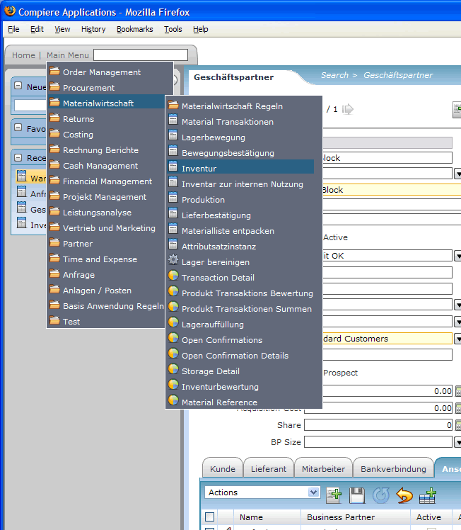
Global-ready Features
Fully internationalized
  Localizations isolated
  from code
  Partners deliver translated and localized Compiere solutions in over 16 languages including for Germany (shown)
Out-of-the-box
support for multiple:
  Business units
  Accounting standards
  Tax laws
  Currencies
Add german screen shot
Notes:
Compiere is ready for the global economy. The application is fully internationalized. The screen shot shows Compiere with a German language Pack. Compiere includes support for one or many of: Organizations, Currencies, Accounting Standards, Languages, Tax Laws and Currencies.
If your business operates in a single region, with a single set of books and a single language, all of these features are invisible. Proceed with the confidence that the global-ready features are there if you need them.

Slide 9
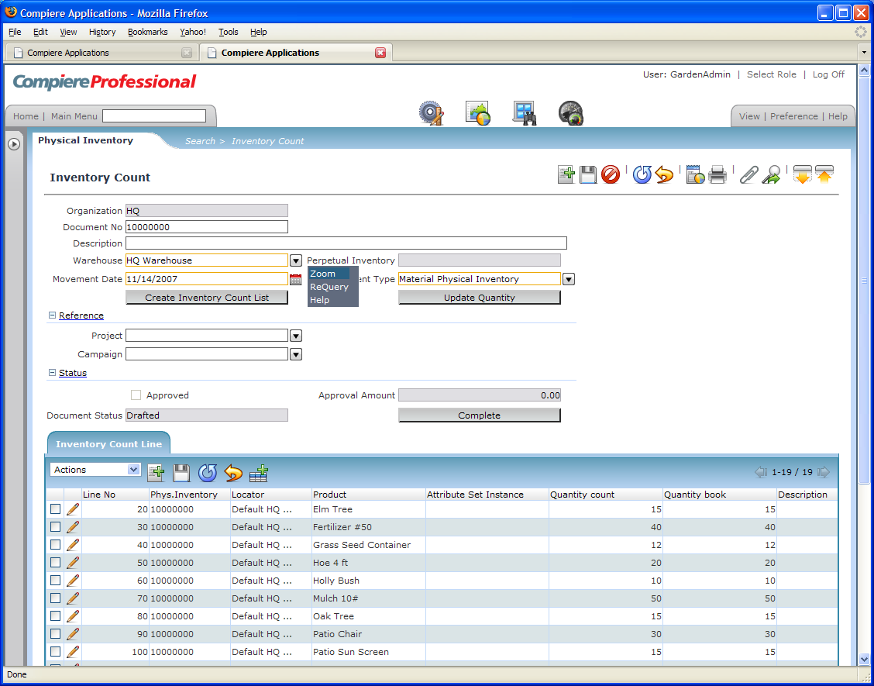
Modern Web Architecture and UI
First mid-market ERP
with a modern RIA
Web architecture
Great user experience
  Rich functionality
  Optimized usability
  Highly responsive
  Personalized interface
Standards-based design
  Service Oriented Architecture
  AJAX features through open source Google Web Toolkit
Notes:
Compiere’s Web architecture is also an innovative standout. It is the first mid-market ERP solution with a modern rich internet application Web architecture. User’s love working in the Web UI because it offers rich functionality, optimized usability, responsiveness and personalization. The Web UI leverages the latest standards-based technologies including Service Oriented Architecture and Google Web Toolkit.
I’ll provide you with a demo…

Slide 10
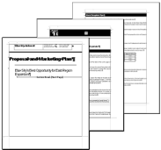
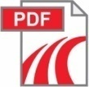

End User Reporting
Compiere Today
Business Views
Multiple Reporting Templates
Multiple Formats
AD
Centralized Data Source
Secure
Grouping, Aggregation
Layout, Ordering
PDF, CSV, Excel
Live Document
End User Layer
Dynamic Views
In-Built Application Context
Database Connection Access
Reporting Integration
Third Party Reporting
Data Warehouse
ETL
Jasper – Pentaho - Crystal
Notes:
First – let’s step back and look and the Warehousing in general. This consists of three main process areas:
INBOUND: This is the handling of goods coming into a facility. Most commonly, these goods are associated with purchases so the receiving process is performed against a Purchase Order. However there are a variety of other sources of receipts. These include Customer Returns where the receipt is against a RMA from the Order System; Transfers associated with Inter-Warehouse movements within the corporation; and possibly receipts of material on a Manufacturing Work Order that had been sent to an external organization for outside processing. Following receipt from these various sources, the material may be inspected and then put away into the most appropriate storage locations.
INTERNAL PROCESSING: are all of the processes associated with the internal handling of the inventory. These include Accuracy, either through Physical Inventory Counts or Cycle Counts; intra-warehouse movements and Replenishment activity; Picking – for Customer Orders, internal Manufacturing, Transfers, etc. and possibly Packing activities; etc. It may also include Assembly into kits or even light manufacturing within the warehouse. Warehouses aren’t just for storage anymore and these value added and deferment activities are a vital part of any warehousing workload.
OUTBOUND: Is the reverse of the receiving process and has a similar set of possible transaction sources. Most commonly, outbound shipments are associated with Customer Orders, however the other possible sources are the mirror image of the Receiving sources: Vendor Returns associated with Purchase Orders, Transfers associated with Inter-Warehouse movements within the corporation, and Work Order shipments to outside processors.
It is clear from this overview that any Warehousing System needs to support a wide variety of processes coming from a similarly wide variety of transaction sources.

Slide 11
Product Contribution Process
Discuss contribution with Compiere
  Compiere will advise if appropriate for base product
Execute Contribution Agreement and submit contributed software
Compiere will test & integrate into a base release
Customer / Partner may participate in testing
Contribution released & supported in base product

Slide 12
Configurability & Extendibility

Slide 13
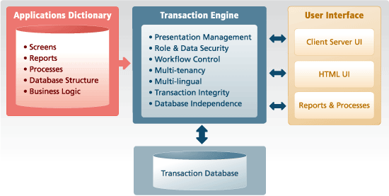
Model-driven Application Platform
  Business logic stored in applications dictionary not hard-coded into programs
  Customize business logic and user interaction without programming
  Customizations remain in place, even through software upgrades
Notes:
Compiere employs an innovative model-driven Architecture that gives you unprecedented adaptability, speed of deployment and low cost of ownership. It is composed of an Applications Dictionary, a Transaction Engine and a Transaction Database. The Applications Dictionary is the repository of business logic meta-data such as window, field, report and workflow definitions. The Transaction Database is the repository for your transaction (e.g. invoices) and set-up (e.g. customer) data. The Transaction Engine manages the interplay between business logic from the Applications Dictionary, transaction data from the Transaction Database and user requests.
The significant breakthrough in the Compiere Model-driven Platform is that it stores business logic in an applications dictionary rather than being hard-coded into software programs. At runtime, The Compiere Transaction Engine reads and writes information from the applications dictionary and the transactions database, utilizes the business logic to assemble windows and data and present the results to the user.
Advantages of this design include the ability to customize the application without programming. Further, your customizations remain in place over the lifetime of your solution, even through upgrades to newer versions of Compiere software.

Slide 14
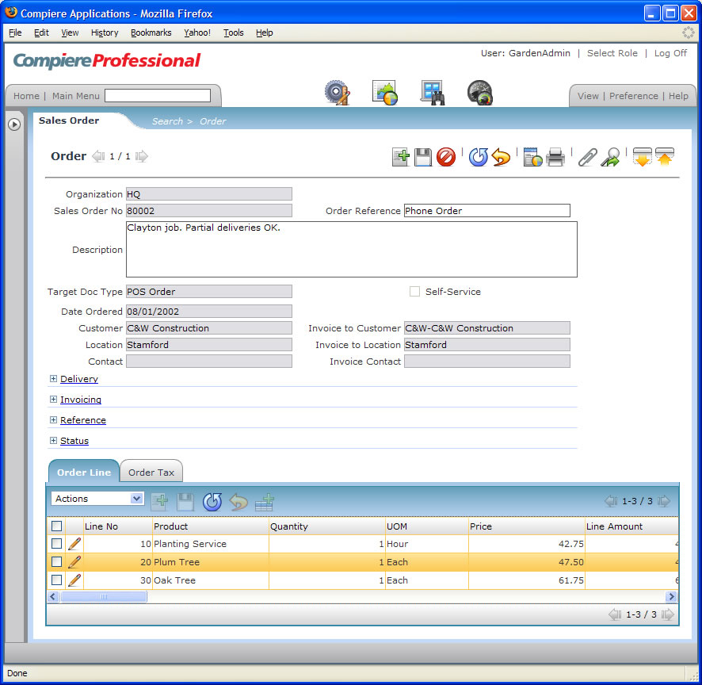
Customization without Programming
Easy & manageable customizations through the Applications Dictionary include:
Add new windows
Add fields
Change field names
Dynamically hide fields
Per user default values
Change window layout
Set security at the row/field level
Notes:
Compiere lets you reconfigure fields, screens and applications without programming. This is a really big deal and only is a benefit that comes from Compiere’s model-driven application platform.
Unlike traditional ERP systems that recommend adapting your business processes to match the default software settings, Compiere encourages you to customize the solution you deploy to match your business needs. As your business environment changes, you can adapt Compiere to your changing needs–quickly and easily.
The model driven architecture separates business logic from application code. This allows you to change the features and appearance of your application by changing field names and screen layouts, dynamically hide fields and set default values on a per user basis, and adding new fields, screens and tables. It also gives your granular control of security down to whether a given role can see a particular field in a particular row.

Slide 15


Configuring & Extending Compiere
… without programming
Configure Business Rules
Application setups
Workflow & security
Accounting Dimensions
Change setups at any time
Configure User Interface
Field, windows, labels
Layout, theme, language
Search fields
Configure Reports
Dynamically create reports
Format reports w/ Compiere or 3rd party report designer
Extend Compiere Applications
Add new fields (DB columns)
Add new entities (DB tables)
Add data validation & defaults
Add new workflows
Change security rules
Add performance measures
Link to external systems
Callout to java processes & integrate results back into UI

Slide 16
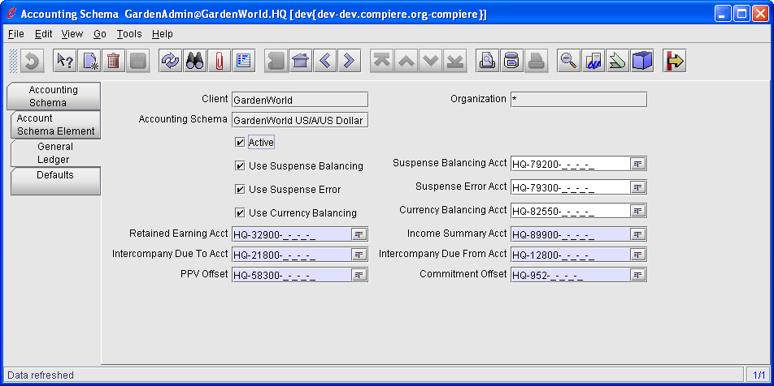
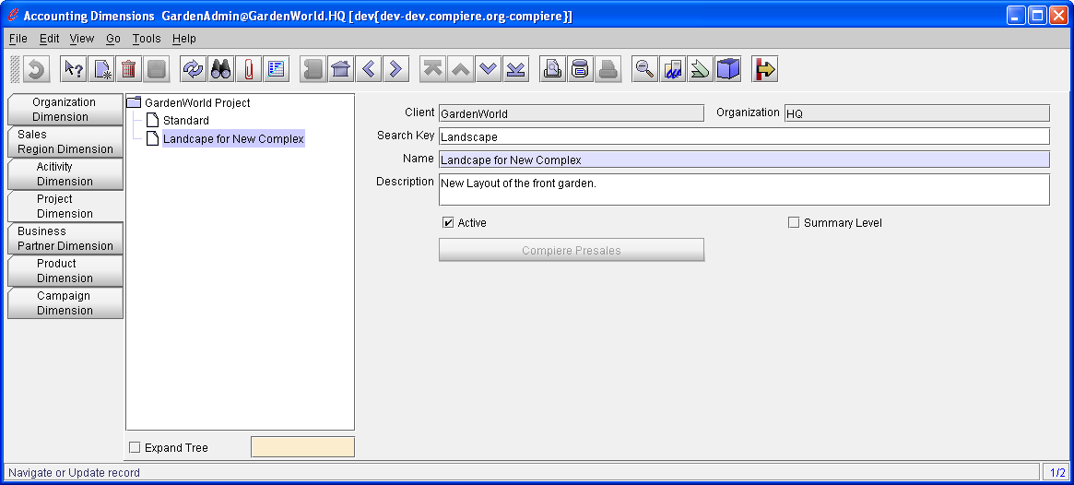
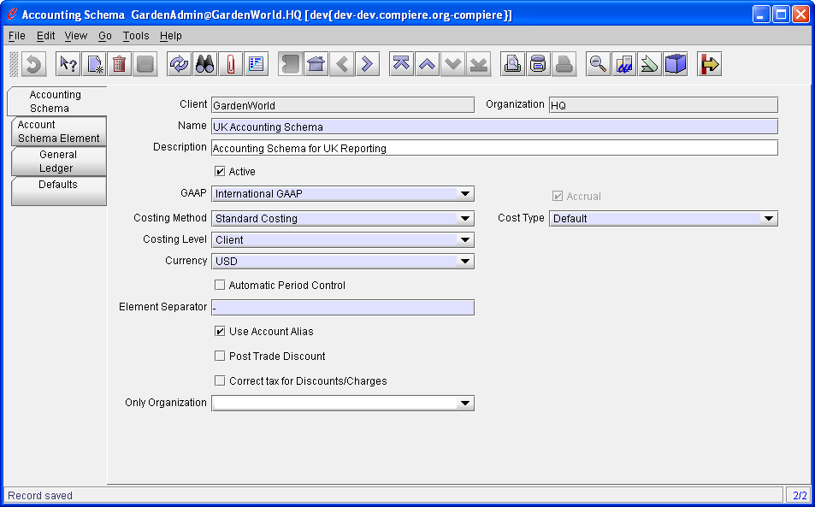
No Final Decisions
Change:
  Accounting
  elements
  Dimensions
  Hierarchies
  Costing methods
…at any time
Notes:
Another key design advantage with Compiere is that there are no final decisions.
Compiere stores transaction data separately from the accounting structure. This gives you significant flexibility with restructuring your Change accounting segments (also known as accounting elements), accounting hierarchies, chart of accounts, financial reporting definitions, and costing schemes.
With Compiere, if your first assertion regarding chart of accounts or business segments or costing are incorrect, you can change them at a later date. This is not the case with the typical ERP solution.

Slide 17
Upgrading to New Versions
Compiere
Migration Server
2. Select new
target version
1. Connect to
Migration Server
Source System
3. Upgrade
Automatically
Upgraded System
Prior Compiere Version
+ Configurations
+ Extensions
Latest Compiere Version
+ Configurations
+ Extensions re-applied
Migration Technology upgrades customer to the latest version
All Dictionary-based configurations & extensions remain in place
Customer applications can be upgraded in the same manner

Slide 18
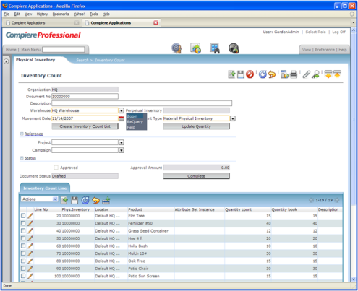
Multi-Tier Web Architecture
Desktop
User Interface
Application
Server
Database
Server
Database
Data Dictionary
- Tables & Columns
- Windows & Reports
- Business Rules
- Workflow
Web
(Ajax-based)
HTTP
Compiere Transaction Engine
JDBC
Java Processes
& Callouts

Slide 19
Disruptive Economics

Slide 20

Compiere Product Offerings
Professional Edition
Premium features
Premium support
Web-based architecture
Rich internet user interface
Private license
Indemnification
$600 / user / year
Standard Edition
Professional support
Bug fixes & service packs
Automated upgrades
GPL public license
$300 / user / year
(2008)

Slide 21
Compiere’s Disruptive Economics
SAP
mySAP
ERP
Oracle
EBS
PeopleSoft
JDE E1
Large
enterprise
Mid-market
Small
Business
Infor
Lawson
Microsoft
Dynamics
SAP
All-In-One
Compiere
Agresso
SAP
ByDesign
Epicor
SAP
Business
One
Exact
Sage
Group
NetSuite
$high thousands/user Cost of Solution $low hundreds/user
Notes:
Our position is that Compiere matches the well known players on delivering ERP business value. The differences are in the economics of open source and the economics of easier. Compiere costs much, much less than traditional products to acquire, implement, customize, use and extend

Slide 22
Customer Success

Slide 23

Compiere Success
Company Overview
  Educational books distribution
  HQ in Georgia; US market focus
  Two warehouses totaling 140,000 ft²
  Hosted Compiere deployment through KnowledgeBlue
Requirements
  Integrated accounting, distribution and warehousing management
  3rd party shipper integration with FedEx, DHL and UPS
  Business-specific reports and dashboards
  Outsourced operations: hosted solution without internal IT/ERP staff
Benefits
  10% increase in net margins through Compiere-related efficiencies
  100% increase in revenue through growth of existing businesses plus entry into a new business that leverages their automated warehouse operations
  Rapid deployment completed on time and in ¼ the time of competing solutions
Notes:
Southern Book Company is a specialty distributor. Historically their business was limited to Educational Books, but since their implementation of Compiere, they are expanding into a broader set of products and markets. More on that later. The company maintains two warehouse facilities: one in Georgia and one in North Carolina. Running their business in two locations with non-integrated technology solutions became a drain on business efficiency. The company sought an ERP solution that could integrate the operations of the two warehouses and provide management with visibility across the entire operations.
The private distributor understands they operate on tight margins, and sought a solution that minimized capital and personnel expenses. A hosted Compiere solutions available from Utah-based KnowledgeBlue had the right cost structure for Southern Book and was rapidly implemented in ¼ the time of competing solutions. KnowledgeBlue extended Southern Book’s solution footprint by including a new module that integrates order management information with 3rd party shippers.
Since going live on Compiere in July 2006, SBC has seen a ten percent increase in net margins and revenue has more than doubled. SBC has even improved customer relationships by enabling customers to securely access real-time inventory data from their Compiere system.

Slide 24
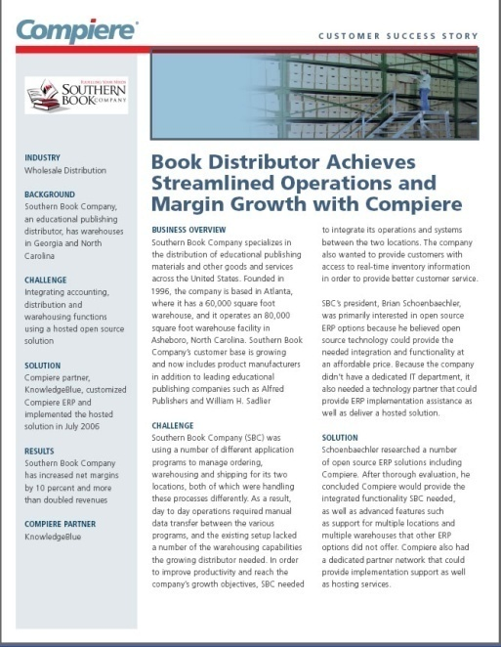
Compiere Success
“ With Compiere’s open source ERP, we’ve increased our net margin by 10 percent during the past two years, and our revenue has more than doubled during that time.”
— Brian Schoenbaechler, President of Southern Book Company
Notes:
Southern Book Company is a specialty distributor. Historically their business was limited to Educational Books, but since their implementation of Compiere, they are expanding into a broader set of products and markets. More on that later. The company maintains two warehouse facilities: one in Georgia and one in North Carolina. Running their business in two locations with non-integrated technology solutions became a drain on business efficiency. The company sought an ERP solution that could integrate the operations of the two warehouses and provide management with visibility across the entire operations.
The private distributor understands they operate on tight margins, and sought a solution that minimized capital and personnel expenses. A hosted Compiere solutions available from Utah-based KnowledgeBlue had the right cost structure for Southern Book and was rapidly implemented in ¼ the time of competing solutions. KnowledgeBlue extended Southern Book’s solution footprint by including a new module that integrates order management information with 3rd party shippers.
Since going live on Compiere in July 2006, SBC has seen a ten percent increase in net margins and revenue has more than doubled. SBC has even improved customer relationships by enabling customers to securely access real-time inventory data from their Compiere system.

Slide 25

Compiere Success
Company Overview
  Pharmaceutical manufacturing
  and distribution
  HQ in Denmark; sales subsidiaries and
  channel partners in 50 countries
  Privately owned with over 500 global employees
Requirements
  Integrated sales order management, inventory control, and global accounting
  Manage product batches, lot numbers and expiration dates
  Platform flexibility, ease of integration and rapid customization
  Open source licensing and Linux platform support
Benefits
  Continuity: Compiere customer since 2002
  Integrated solution scaled from one subsidiary to global operations
  Company-specific extensions easily migrated to new releases over time
  Improved distribution efficiency for 50 product lines and over 10,000 SKUs
Notes:
Pharma Nord is one of Europe's largest manufacturers of preventive dietary supplements and herbal remedies. The company develops, manufactures and markets scientifically well founded dietary supplements, herbal remedies. Company headquarters is in Denmark and houses centralized functions for manufacturing, accounting and information technology. Products are distributed in 50 countries by a mix of subsidiaries and channel partners. The privately owned company was founded in 1981, currently employs 500 people globally and continues to expand its product lines and distribution network.
Pharma Nord’s ERP requirements focused on distribution functions from warehousing products through ordering, shipments, invoicing and accounting management. As a pharmeceutical company, they face stringent and complicated regulatory requirements in companies where they do business. As a result they produce over 50,000 different formulations of 50 base products. They keep track of each product down to batch, serial number and expiry date.
Pharma Nord has a strategic commitment to flexible IT and open source technologies that dates back to 2001. Compiere runs as part of a Linux-based open source IT stack that is both flexible and customized to Pharma Nord’s business requirements.
A customer for more than six years, Pharma Nord’s transaction database includes all history. They’ve stayed with current Compiere technology through Compiere’s Migration tools which preserves customer data and customizations applying new functionality and quality improvements to their platform. The Compiere solution they rolled out initially to a single subsidiary in 2002 is largely the same platform that the company uses globally in 2008. Over those six years, Compiere has kept pace with the expanding scale and complexity of Pharma Nord’s business growth.

Slide 26
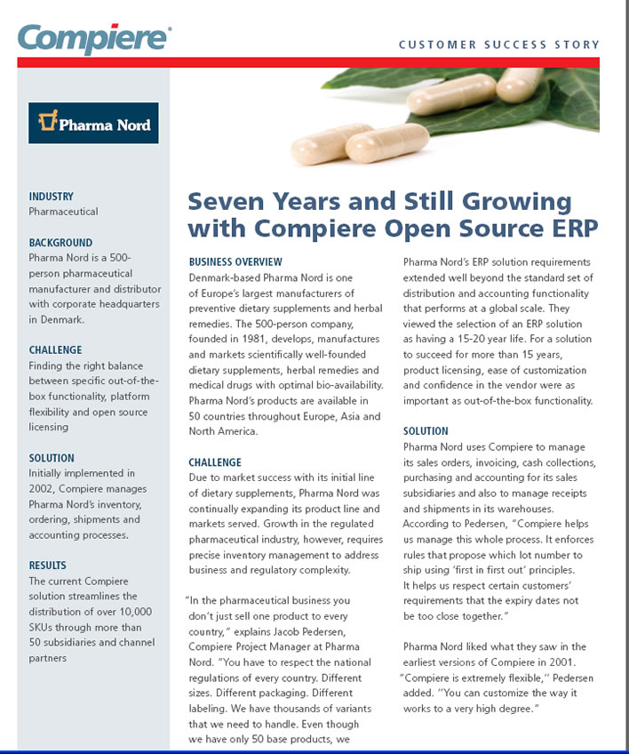
Compiere Success
“ Compiere is extremely flexible. You can customize the way it works to a very high degree.”
— Jacob Pedersen, Project Manager Pharma Nord
Notes:
Pharma Nord is one of Europe's largest manufacturers of preventive dietary supplements and herbal remedies. The company develops, manufactures and markets scientifically well founded dietary supplements, herbal remedies. Company headquarters is in Denmark and houses centralized functions for manufacturing, accounting and information technology. Products are distributed in 50 countries by a mix of subsidiaries and channel partners. The privately owned company was founded in 1981, currently employs 500 people globally and continues to expand its product lines and distribution network.
Pharma Nord’s ERP requirements focused on distribution functions from warehousing products through ordering, shipments, invoicing and accounting management. As a pharmeceutical company, they face stringent and complicated regulatory requirements in companies where they do business. As a result they produce over 50,000 different formulations of 50 base products. They keep track of each product down to batch, serial number and expiry date.
Pharma Nord has a strategic commitment to flexible IT and open source technologies that dates back to 2001. Compiere runs as part of a Linux-based open source IT stack that is both flexible and customized to Pharma Nord’s business requirements.
A customer for more than six years, Pharma Nord’s transaction database includes all history. They’ve stayed with current Compiere technology through Compiere’s Migration tools which preserves customer data and customizations applying new functionality and quality improvements to their platform. The Compiere solution they rolled out initially to a single subsidiary in 2002 is largely the same platform that the company uses globally in 2008. Over those six years, Compiere has kept pace with the expanding scale and complexity of Pharma Nord’s business growth.

Slide 27
Next Steps……..

Slide 28
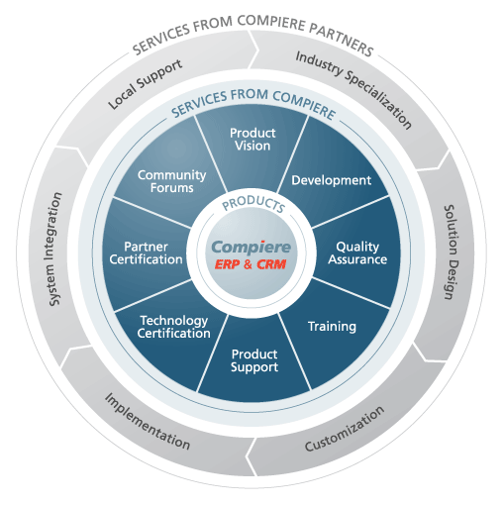
Customer Success with Compiere
The Compiere Product and Partner Ecosystem
Notes:
So far we’ve talked a lot about Compiere technology. Now we’re going to switch gears and talk about solutions and customers.
When customers choose Compiere, they get more than just open source technology, they benefit from the expanded Compiere Product and Partner Ecosystem. The core Compiere product drives a lot of activity around the globe. This picture depicts how Compiere and partners work together in support of customer success.
Compiere takes responsibility for product vision, core development, quality assurance, training, 2nd level product support, technology certification, partner certification and fostering community communications.
Our partners typically are specialists in a particular geography or industry. They provide the expertise and services to deliver a Compiere solution for your business. In addition to industry and geographic specialization, Compiere Authorized partners provide services such as solution design, product customization, implementation and system integration. In many cases customers choose to get their 1st level of support from partners working in the local time zone and language.

Slide 29

Evaluating Compiere for your Business
Information
  Compiere Web site: www.compiere.com
  Compiere Capabilities Overview white paper
  Compiere product demos
  Online introduction webcasts
  Compiere Documentation
Software
  Compiere Community Edition binary software
  Compiere Community Edition source code
Training
  Aug 11 – 15th - Functional Training
  Aug 18 – 20th - Technical Training
  On-demand eLearning
Partner Network Services
  Needs analysis
  Pilot and production deployments
  Industry- and region-specific solutions
Questions?
  david@engynit.com.au
  www.engynit.com

Slide 30
Thank you

